Slide 1
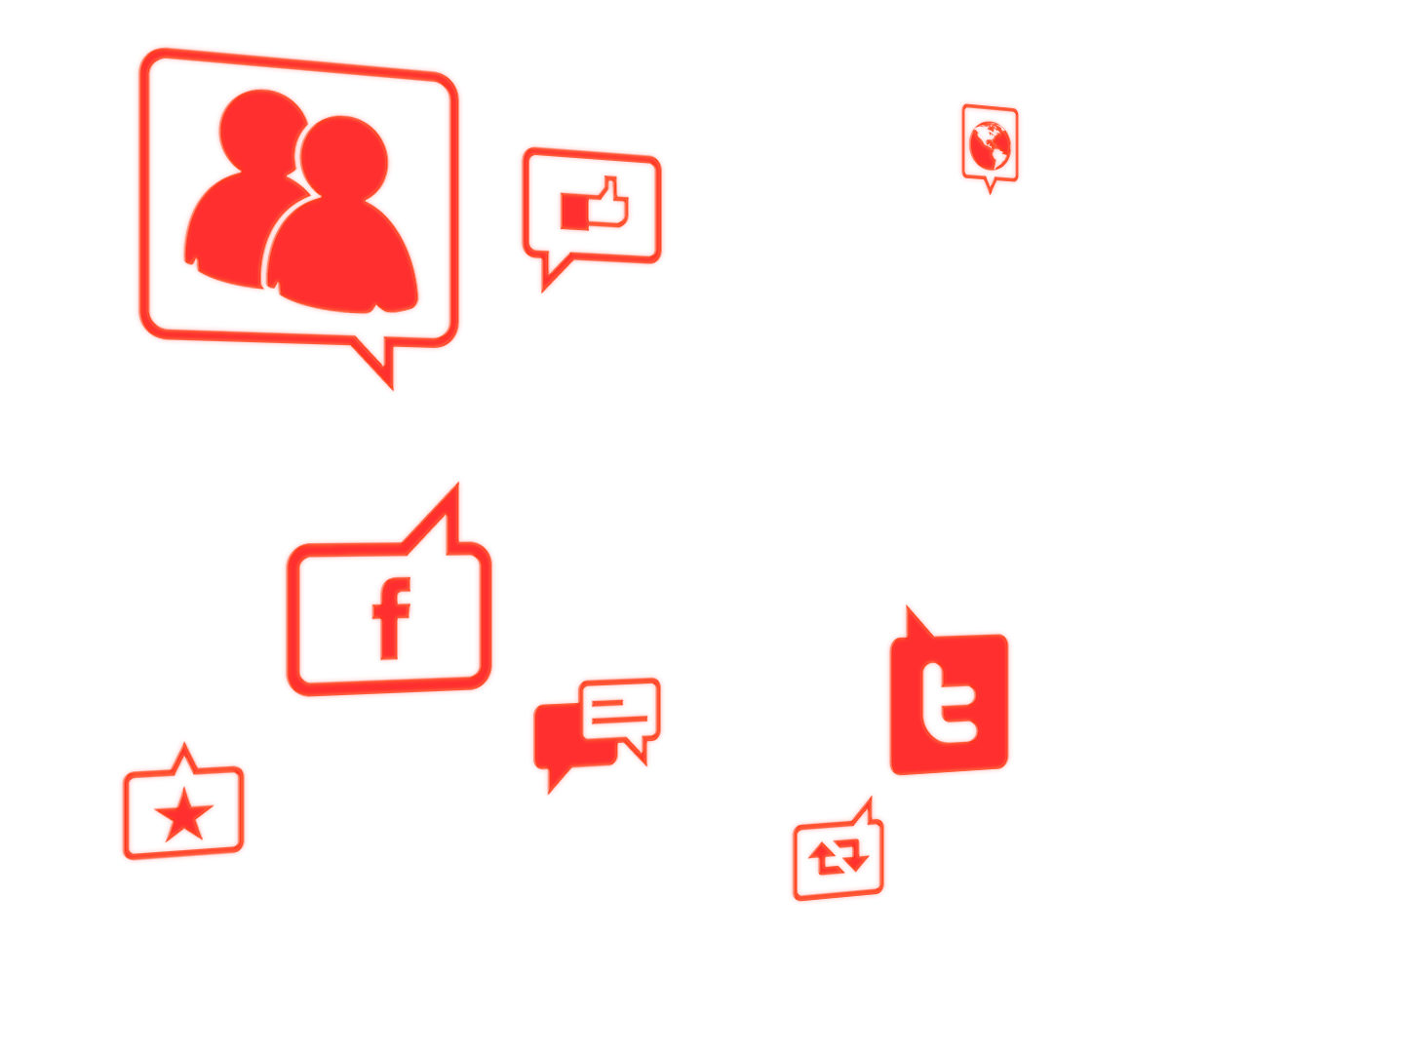
Fuel the Conversation
With Social Media Features

Slide 2
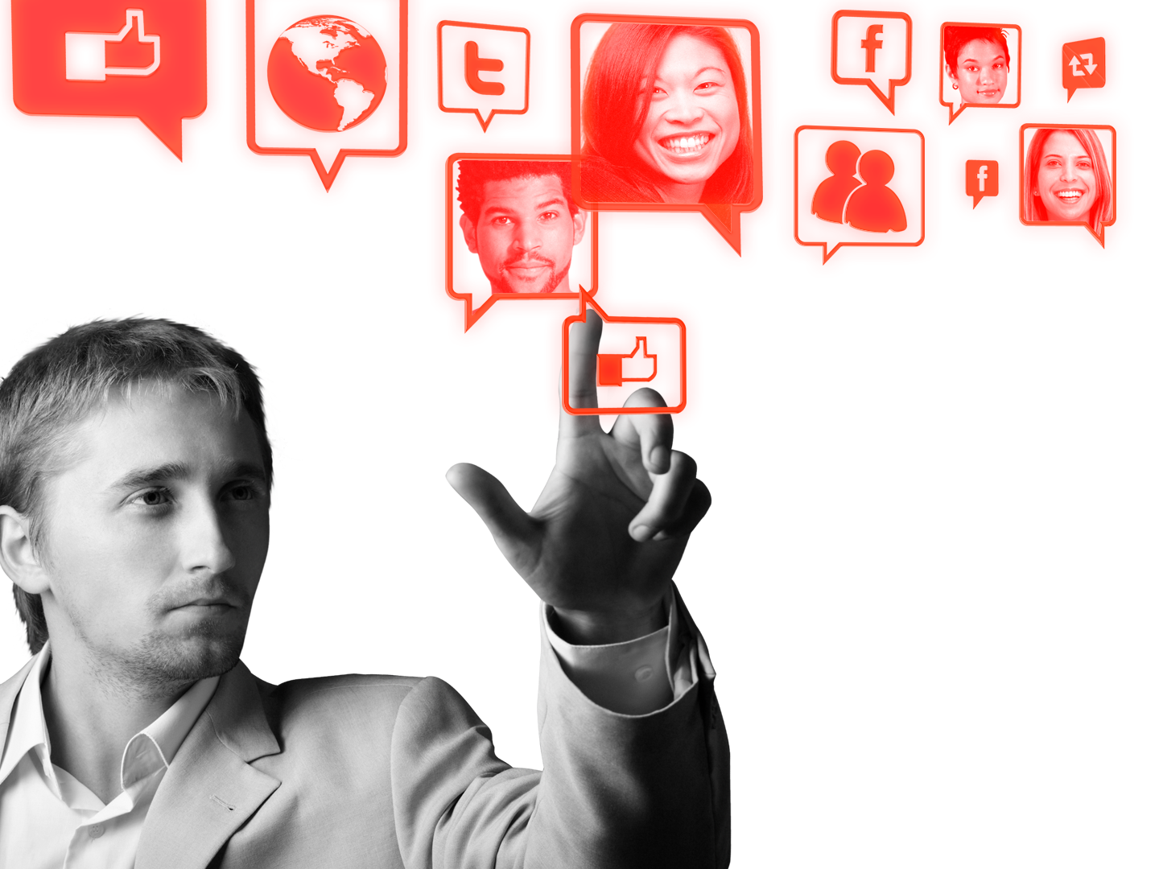
Social Media is about being more than friends.
By itself, Social Media can only take your message so far.
But as part of a well-planned, digital marketing strategy that includes paid, earned, and owned media, it is a powerful way to create awareness and drive engagement.
Notes:
Consumers are everywhere, and marketers need to discover new ways to connect with them, whenever and wherever they are living their social lives.
Successful media campaigns generate earned media through paid media solutions. As the navigator of digital possibilities, Microsoft Advertising delivers the audience, environment and multi-screen premium ad experiences that brand advertisers need to generate the consumer engagement to fuel earned media, and achieve their social media objectives.
Paid media: Advertising as you know it.
Earned media: Getting people to talk about your brand and share your content, providing free and trusted word of mouth publicity.
Owned media: A channel you create and control, from your website to your Facebook® fan page, or your WindowsLive™, YouTube™ or Twitter accounts.
While brand fan pages help fuel social media, rich media, targeting and creative technical executions optimize paid media, driving 69% more traffic to brand sites and 3x more brand searches. (Microsoft Research, Dwell on Branding – March 2010)

Slide 3
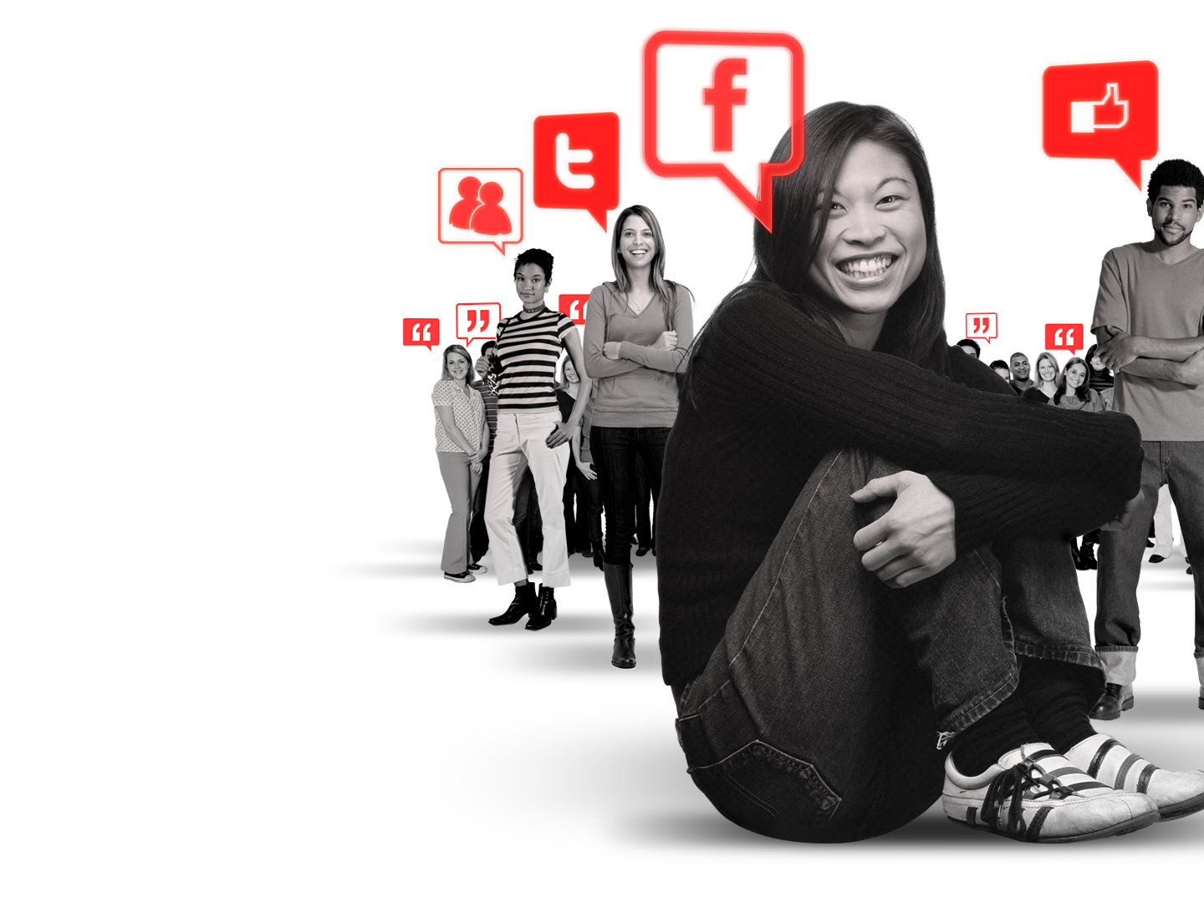
How do you fuel the conversation?
While social media can add value to your existing efforts, it takes more than a Facebook page and a Twitter account. Conversations don’t start themselves.
That’s where Microsoft Advertising can help.
Our paid media, including Social Features, connects you with consumers where they are living their digital lives – on Facebook, Twitter and Windows Live Messenger.
Notes:
Here are some interesting statistics proving that the only way to generate earned media is through paid media:
75% of Facebook users polled in September 2010 said that an ad is what spurred them to like a brand. (DDB Worldwide and Opinionway Research, “Facebook and Brands,” Oct 11, 2010)
61% of users unsubscribe from a brand due to poor sustained messaging efforts. (DDB Worldwide and Opinionway Research, “Facebook and Brands,” Oct 11, 2010)
22% of users unsubscribe because the information was not interesting. (DDB Worldwide and Opinionway Research, “Facebook and Brands,” Oct 11, 2010)
7% of users unsubscribe because the information was not updated frequently and 32% of users unsubscribe because they lost interest in the brand. (DDB Worldwide and Opinionway Research, “Facebook and Brands,” Oct 11, 2010)
-------
We can reach an engaged audience of 720 million users who are already interacting with one another through our MSN properties, like MSNBC, Windows Live, Xbox LIVE and our mobile environment. (Microsoft Internal)
We offer a seamless experience through a trusted environment, utilizing our social tools that are already deeply integrated into MSN, Windows Live and Bing.
44% of online gamers also connect and socialize with others through popular consoles, like Xbox, and web properties, such as Xbox LIVE. (Wunderman Study: “What’s on their Screens, What’s on their Minds: Reaching and Engaging the Multi-Screen Consumer.” 2010)
Nearly 52 million visitors go to Facebook from Microsoft sites – that’s more than the combined populations of Spain and New Zealand. Over 49 million come to Microsoft sites from Facebook. (http://en.wikipedia.org/wiki/List_of_countries_by_population- June 2010 Comscore Key Measures Data (51.8 Million Microsoft Sites UUs, source traffic))
While Facebook offers advanced profile targeting (interests, groups), re-messaging and other advanced targeting solutions on MSA delivers additional brand engagement

Slide 4
Social Features that
get people talking.
Our Social Features can help you create an immediate, stand-alone social media element to your campaign, or a quick and easy enhancement to any existing rich media banners.

Slide 5
Social Polls invite people to share their votes in response to brand-sponsored questions.
You can then aggregate poll results across all of your placements and enable people to post comments to Facebook, Twitter and Windows Live.
Notes:
You can get immediate and specific feedback on total engagements, poll results, result breakout among different targets, sharing rates and reengagement rates from shared polls.

Slide 6
Social Streams display positive messages from Twitter and other commenting platforms about an advertiser or campaign.
Employ real comments from fans, consumers, bloggers and corporate Twitter accounts.
Invite users to join the conversation by leaving their own message or clicking on any message to learn more.
Notes:
This product also offers accurate and immediate reporting on click through rates, engagements and tweets.

Slide 7
Social Video Players enable people to easily re-post videos to their Facebook, Twitter and Windows Live accounts using built-in icons.
Add additional social actions, such as a social poll or quiz, after the video completes to spread your message even further.
Notes:
Advertisers can track all interactions with video, from starts to percentage completed and breakout of sharing between platforms.

Slide 8
Social Momentum utilizes the power of peer influence to reinforce a call to action.
Dynamically create socially relevant messages for each person to show the popularity of the product in their community.
Track, in real time, which messages and which communities are driving the strongest results.
Notes:
The relevant social data will create peer influence and community endorsement to significantly increase performance.

Slide 9
Social Hubs pull together multiple social actions, enabling people to use social streams, social videos, social polls and social momentum to fully engage with a brand.
Harness all the functionality of a micro-site with the reach of an ad unit, or create a one-stop unit that drives social engagement, pulls in content from the largest social communities and pushes out multiple interactions.
Notes:
User action can be tracked, allowing you to follow: expansions, video starts, video completes, how often content is shared, poll response rates and the number of likes.
We can build a social hub into any large rich media ad unit. This includes the MSN Pushdown, the MSN sidekick, 3-D page cube, Messenger Marquee, Hotmail Pushdown, etc.
Technically, we can implement this combination of features anywhere on our network, but we will need a large ad unit to really showcase all that a social hub has to offer.

Slide 10
Get in with the right crowd.
Developed to reach over 100 different market segments with thousands of possible combinations, our targeting solutions enable you to reach whichever audience you want, where they are, through behavioral, profile and custom targeting.
Reach internet power users, teen influencers, social media users, daters, and many more.
Notes:
A breakdown of some of our segments:
The Internet Power User. She is online 24/7 and can’t live without the internet. You can find her checking her email or uploading her favorite picture online.
The Teen Influencer. She is a busy teenager who reads up on fashion news online, searching for the latest summer dresses and tweeting her friends about the latest summer fashions.
The Social Media User. She is busy texting her friends, playing games on her cell phone or blogging online.
The Daters. These are people making social connections online.

Slide 11
What do these campaigns look like?
Advertisers like Old Spice, O’Boy, Nike, Burger King and Ford are redefining what makes a great marketing campaign.
Using traditional advertising, intertwined with a digital strategy comprised of websites, rich media and social media, they have blurred the lines between paying to get their message out and using consumers to promote their brand through word of mouth.
Taking advantage of these new tactics and knowing when and where to implement them is now the difference between a success story and no story.
Notes:
Examples of great marketing strategy becoming great social stories:
Old Spice’s “The Man Your Man Could Smell Like” spot from Wieden + Kennedy Portland was launched in February during the Super Bowl. It featured Isaiah Mustafa, a former NFL athlete, in excellent, compelling creative and became an almost immediate hit online.
The campaign got its start from traditional TV commercials, supplemented by cinema ads (paid). Then the campaign migrated to an interactive mix of brand microsite with Facebook and Twitter pages (owned), and continued its momentum through consumer interaction and word-of-mouth on social sites and beyond (earned). Finally, the campaign gets continued lift from additional online advertising -- both banner and video ads -- which FUELED traffic back to the brand's site and social-media pages.
-More people watched its videos in 24 hours than those who watched Obama’s presidential victory speech
-Total video views reached 40 million in a week.
-Campaign impressions: 1.4 billion.
-Since the campaign launched, Old Spice Bodywash sales are up 27%; in the last three months up 55%; and in the last month up 107%
O’Boy: The manufacturers of O’boy, a typical ‘after-school’ drink, wanted to find new ways to engage with its consumers. Specifically looking to target Norwegian teenagers, the main objective was to create a buzz around the drink via branded, integrated content and real time involvement. That’s where Microsoft Advertising came in, and a partnership was formed.
The O’boy campaign kicked off with a specially created bespoke MSN area featuring a mini-golf game (547,400 games played), a downloadable Windows Live Messenger Personal Expression Pack distributing O’boy emoticons and wallpapers, a Windows Live Messenger Tab which was opened over 22, 000 times, and Facebook integration which grabbed over 45, 000 interactive fans. All this activity was supported by banner placements on Windows Live and on the Microsoft Advertising Network.
The campaign was a huge success and O’boy’s market share rose to an all-time high with an increase of 5%. Partnering with Microsoft Advertising allowed Oh boy to target an exact audience thanks to innovative and interactive solutions on MSN and Windows Live Messenger.
PULL-OUT STATS:
177,719 total visits
547,400 total games played
3.1 average games played per visit
8 min 16 sec average time spent per visit
QUOTE:
“Microsoft Advertising helped us realise how important it is to get actively involved with your key audience, helping them to buy into the brand. The interactive offerings really make a huge difference.”

Slide 12
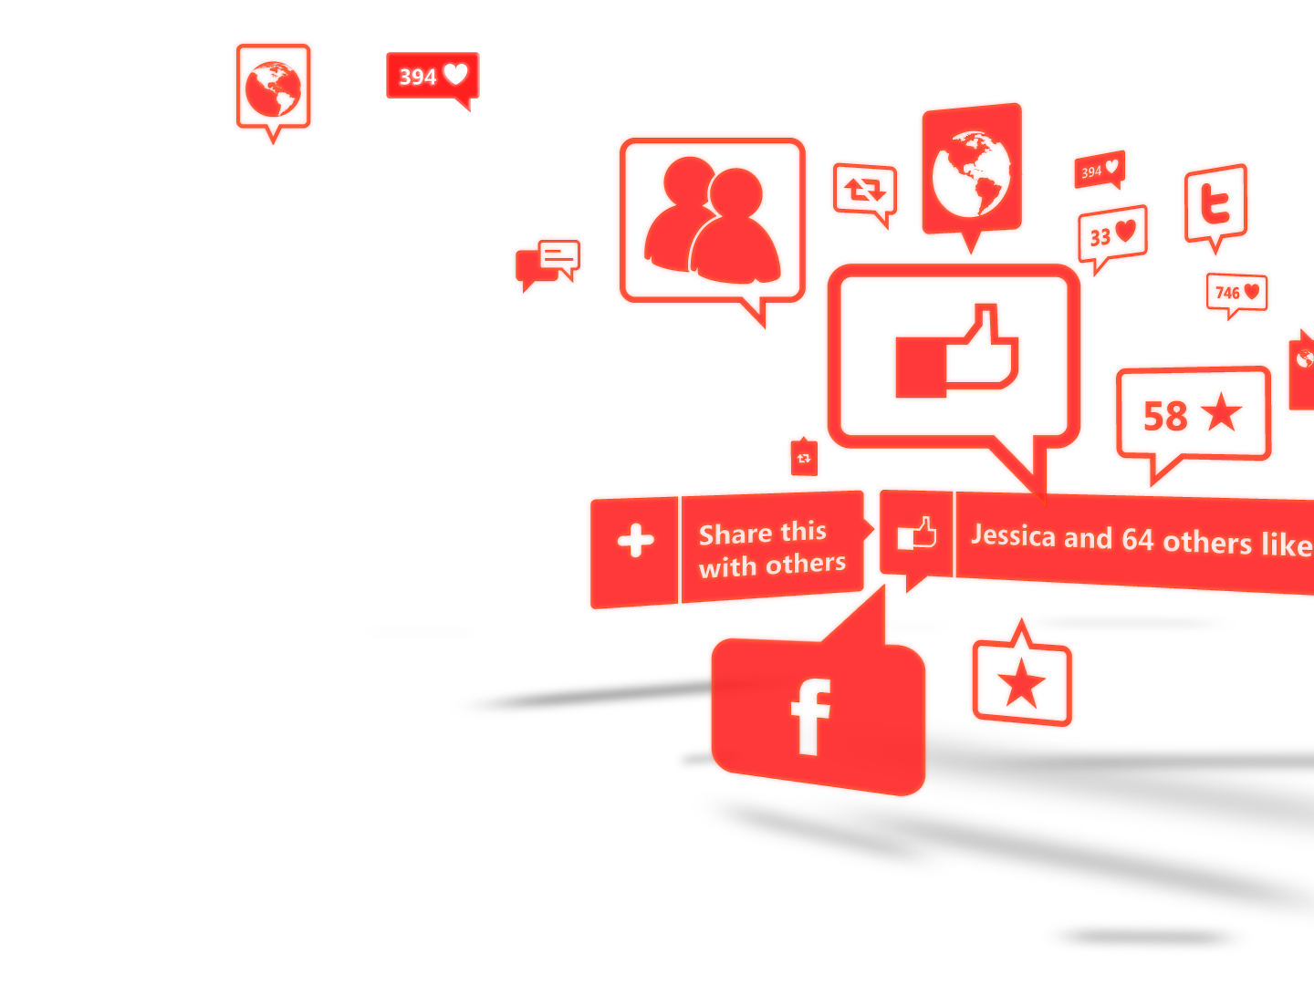
Create more than just a talking point.
Microsoft Advertising offers a user friendly and creative product suite that drives awareness and engagement through social media. Successfully enhancing your marketing plan, delivering on your digital objectives and effectively using paid media to generate earned media.

Slide 13
Case Study
Aenean eu leo quam. Pellentesque ornare sem lacinia quam venenatis vestibulum. Donec id elit non mi porta gravida at eget metus. Maecenas sed diam eget risus varius blandit sit amet non magna.

Slide 14
Social Media Capability by Vendor
 | Geo Region |  |  |  | Social Feature
Vendor | US | EMEA | Americas | APAC | Social Polls | Social Video | Social Streaming | Social Momentum | Social Hubs
Unicast | X | X |  |  | yes | yes | yes | yes | yes
SocialMedia.com | X |  |  |  | yes | yes | yes | yes | yes
Eyewonder | X | X |  |  | yes | yes | yes | yes | yes
Pointroll | X |  |  |  | yes | yes | yes | yes | yes
Interpolls | X | X |  |  | yes | yes | yes | yes | yes
MediaMind/Eyeblaster | X | X | X | X | yes | yes | yes | yes | yes
AdMotion |  | X | X |  | yes | yes | yes | yes | yes
Notes:
Here is a list of our rich media vendors who have confirmed that they can implement these social features, as well as a summary of their geo coverage.

Slide 15
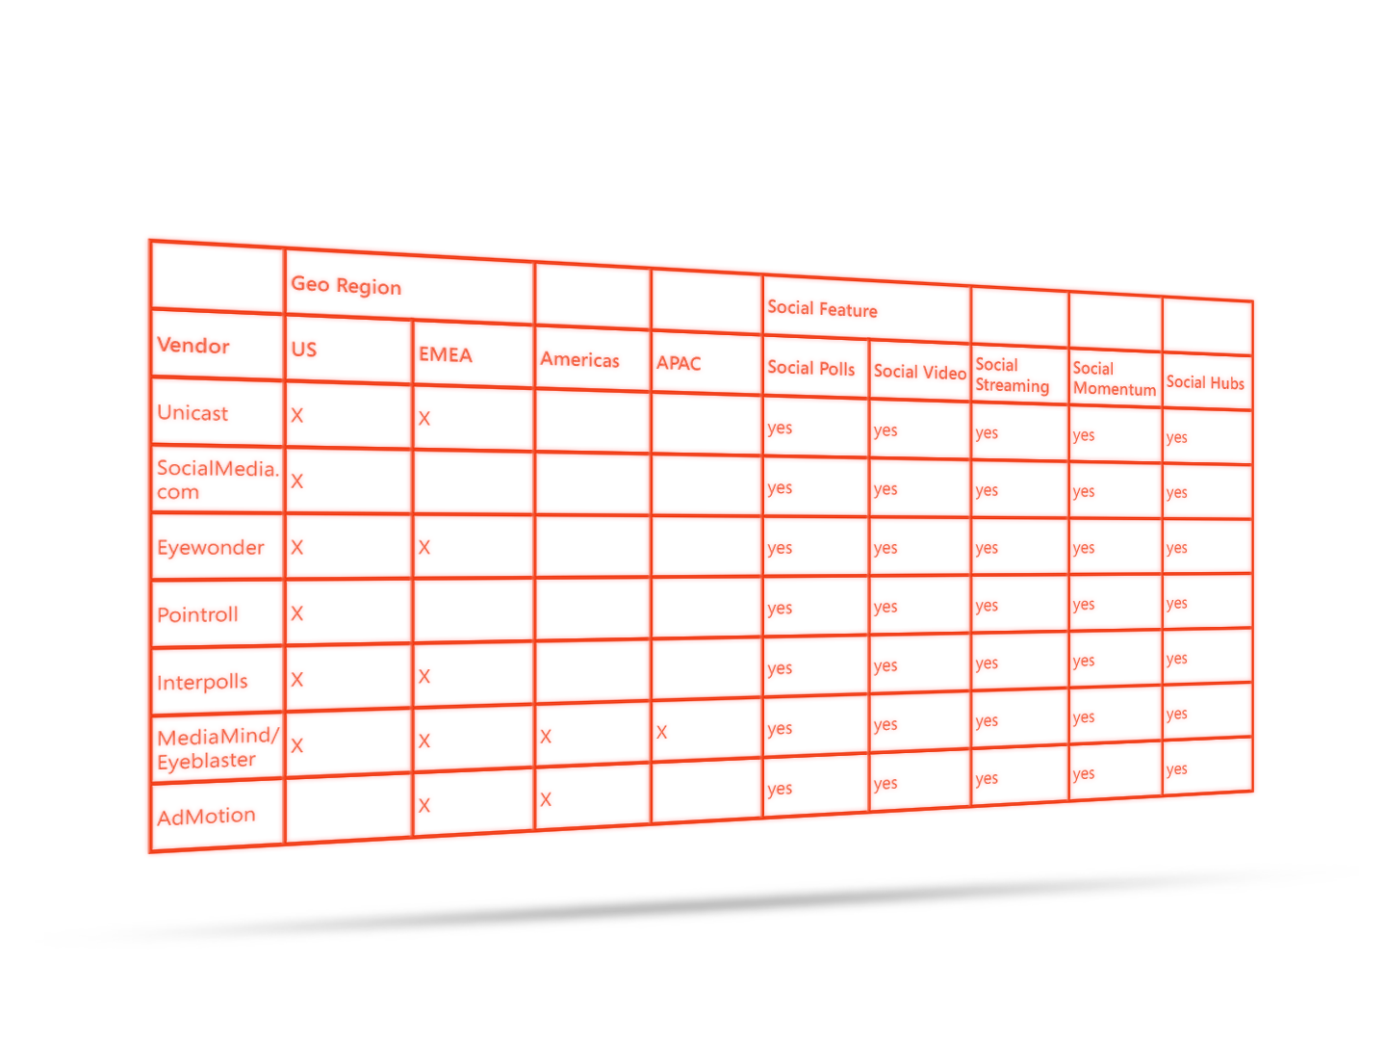
Social Media Capability by Vendor
Notes:
Here is a list of our rich media vendors who have confirmed that they can implement these social features, as well as a summary of their geo coverage.

Slide 16
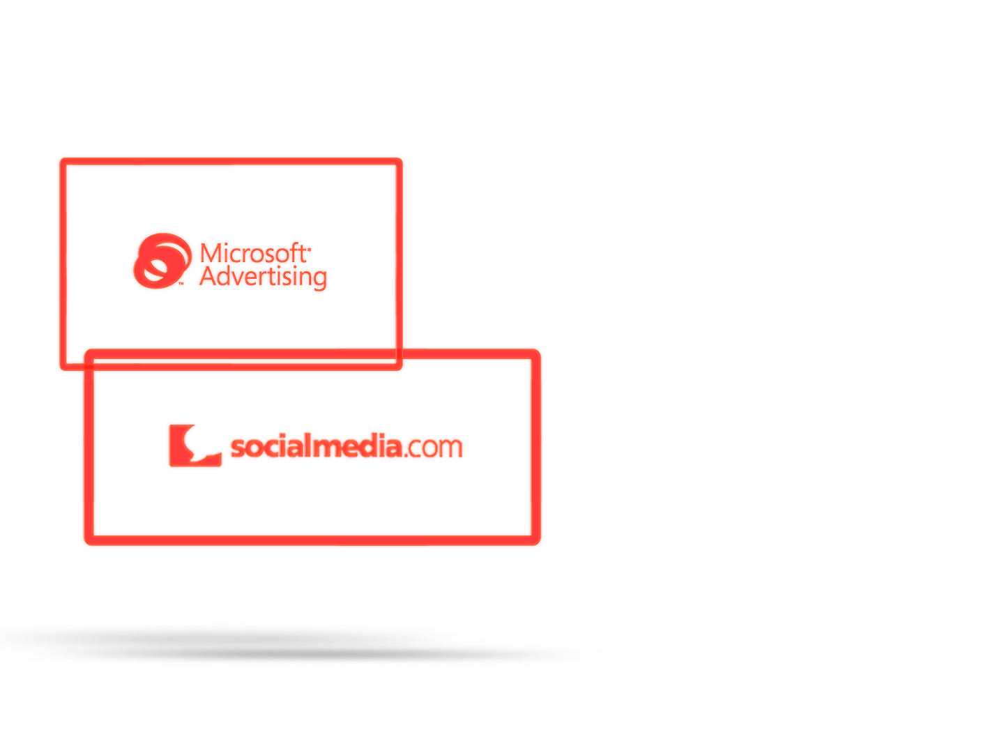
The Partnership Behind Social Media
Aenean lacinia bibendum nulla sed consectetur. Donec id elit non mi porta gravida at eget metus.
Donec ullamcorper nulla non metus auctor fringilla. Nullam id dolor id nibh ultricies vehicula ut id elit.
Fusce dapibus, tellus ac cursus commodo, tortor mauris condimentum nibh, ut fermentum massa justo sit amet risus.
Notes:
We are excited to announce our new partnership with socialmedia.com!

Slide 17
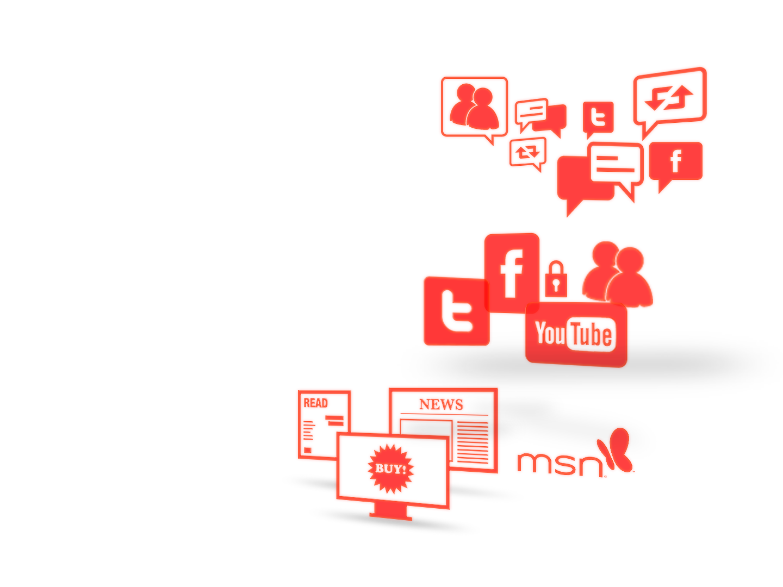
Media: Paid vs Earned vs Owned.
Microsoft Advertising provides all the options available to deliver on your specific marketing objectives.
Paid media is advertising as you know it.
Earned media is getting people to talk about your brand and share your content, providing free and trusted word of mouth publicity.
Owned media is a channel you create and control, from your website to your Facebook® fan page, or your WindowsLive™, YouTube™ or Twitter accounts.

Slide 18
The Strategy Behind Social Media.
When you put our marketing expertise and social media tools to work in the multitude of properties and environments we can access, you not only generate consumer awareness, but you take consumer engagement to a whole new level.
Notes:
We can reach an engaged audience of 720 million users who are already interacting with one another through our MSN properties, like MSNBC, Windows Live, Xbox LIVE and our mobile environment. (Microsoft Internal)
We offer a seamless experience through a trusted environment, utilizing our social tools that are already deeply integrated into MSN, Windows Live and Bing.
44% of online gamers also connect and socialize with others through popular consoles, like Xbox, and web properties, such as Xbox LIVE. (Wunderman Study: “What’s on their Screens, What’s on their Minds: Reaching and Engaging the Multi-Screen Consumer.” 2010)
Nearly 52 million visitors go to Facebook from Microsoft sites – that’s more than the combined populations of Spain and New Zealand. Over 49 million come to Microsoft sites from Facebook. (http://en.wikipedia.org/wiki/List_of_countries_by_population- June 2010 Comscore Key Measures Data (51.8 Million Microsoft Sites UUs, source traffic))
While Facebook offers advanced profile targeting (interests, groups), re-messaging and other advanced targeting solutions on MSA delivers additional brand engagement.

Slide 19
What is a Great Marketing Strategy?
A brand message that resonates with your consumers will spur word of mouth, or in this day and age, digital word of mouth. And we all know that social media is the platform that supports this conversation.
Your digital strategy should take this new and effective media channel into account and, most importantly, offer you ways to fuel the conversation once it starts.
And a paid media solution is the best option when it comes to activating and supporting your earned media strategy.
Notes:
Advertisers like Old Spice, Nike, Burger King and Ford are redefining what makes a great marketing campaign.
Using traditional advertising, intertwined with a digital strategy that comprises of websites, rich media and social media, they have blurred the lines between paying to get your message out and using consumers to promote their brand through word of mouth.
Understanding these new tactics and knowing when and where to implement them is now the difference between a success story and no story.
Examples of great marketing strategy becoming great social stories:
Old Spice’s “The Man Your Man Could Smell Like” spot from Wieden + Kennedy Portland was launched in February during the Super Bowl. It featured Isaiah Mustafa, a former NFL athlete, in excellent, compelling creative and became an almost immediate hit online.
The campaign got its start from traditional TV commercials, supplemented by cinema ads (paid). Then the campaign migrated to an interactive mix of brand microsite with Facebook and Twitter pages (owned), and continued its momentum through consumer interaction and word-of-mouth on social sites and beyond (earned). Finally, the campaign gets continued lift from additional online advertising -- both banner and video ads -- which FUELED traffic back to the brand's site and social-media pages.
-More people watched its videos in 24 hours than those who watched Obama’s presidential victory speech
-Total video views reached 40 million in a week.
-Campaign impressions: 1.4 billion.
-Since the campaign launched, Old Spice Bodywash sales are up 27%; in the last three months up 55%; and in the last month up 107%
O’Boy: The manufacturers of O’boy, a typical ‘after-school’ drink, wanted to find new ways to engage with its consumers. Specifically looking to target Norwegian teenagers, the main objective was to create a buzz around the drink via branded, integrated content and real time involvement. That’s where Microsoft Advertising came in, and a partnership was formed.
The O’boy campaign kicked off with a specially created bespoke MSN area featuring a mini-golf game (547,400 games played), a downloadable Windows Live Messenger Personal Expression Pack distributing O’boy emoticons and wallpapers, a Windows Live Messenger Tab which was opened over 22, 000 times, and Facebook integration which grabbed over 45, 000 interactive fans. All this activity was supported by banner placements on Windows Live and on the Microsoft Advertising Network.
The campaign was a huge success and O’boy’s market share rose to an all-time high with an increase of 5%. Partnering with Microsoft Advertising allowed Oh boy to target an exact audience thanks to innovative and interactive solutions on MSN and Windows Live Messenger.
PULL-OUT STATS:
177,719 total visits
547,400 total games played
3.1 average games played per visit
8 min 16 sec average time spent per visit
QUOTE:
“Microsoft Advertising helped us realise how important it is to get actively involved with your key audience, helping them to buy into the brand. The interactive offerings really make a huge difference.”

